Slide 1
Heart Disease Diagnostic Analysis

Slide 2
Introduction
Heart disease remains a leading cause of mortality globally, underscoring the critical need for accurate and timely diagnosis. In this context, data analysis emerges as a powerful tool, revolutionizing the way we approach heart disease diagnosis. By leveraging the vast amounts of data available, we can gain valuable insights, enhance predictive capabilities, and ultimately contribute to more effective healthcare strategies.

Slide 3
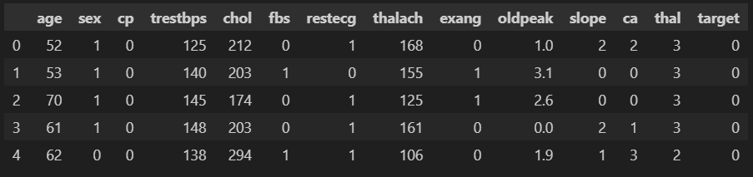

Details of Data

Slide 4
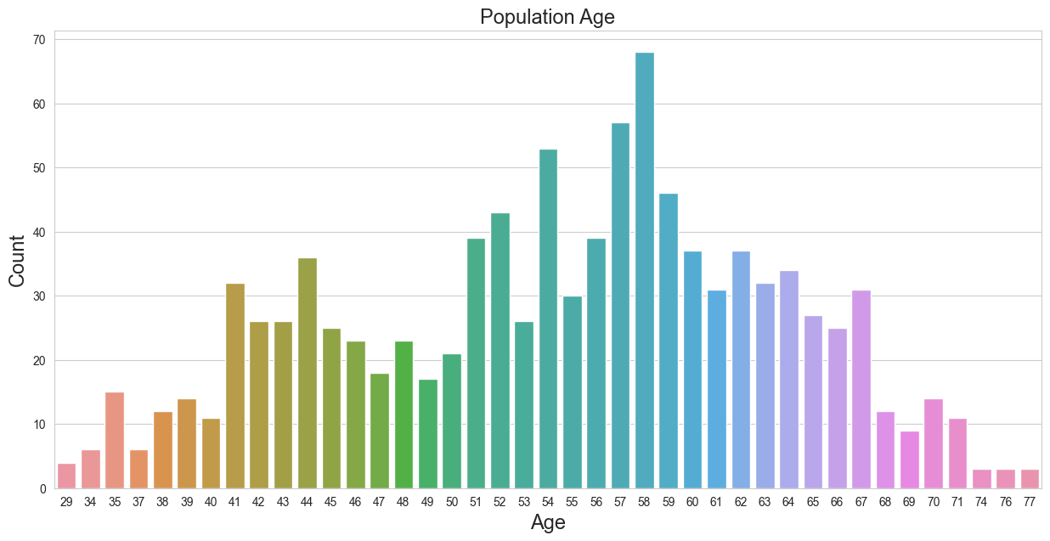
Data Analysis

Slide 5
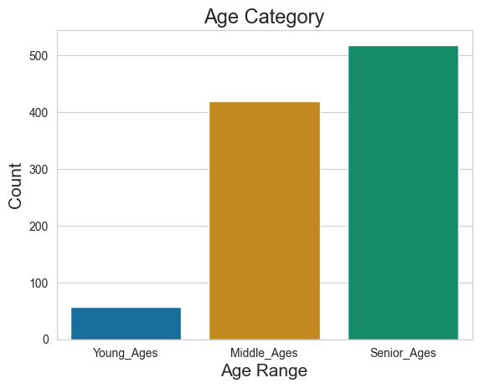
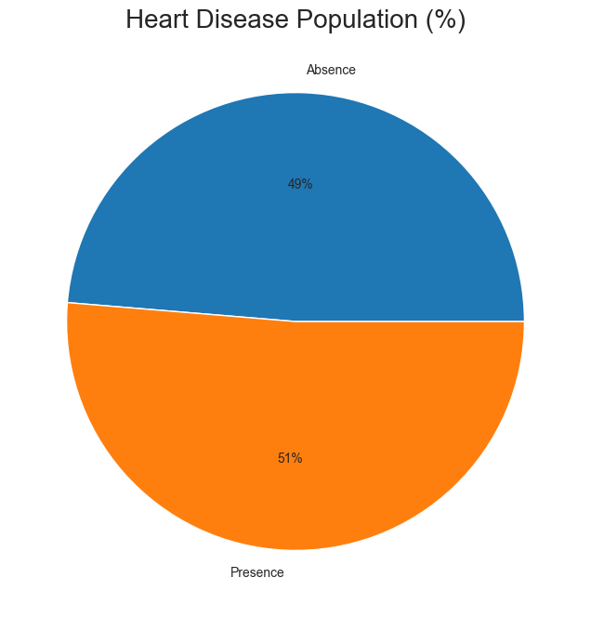
Data Analysis

Slide 6
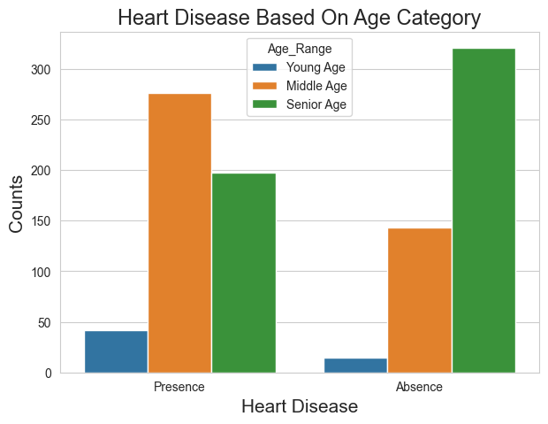
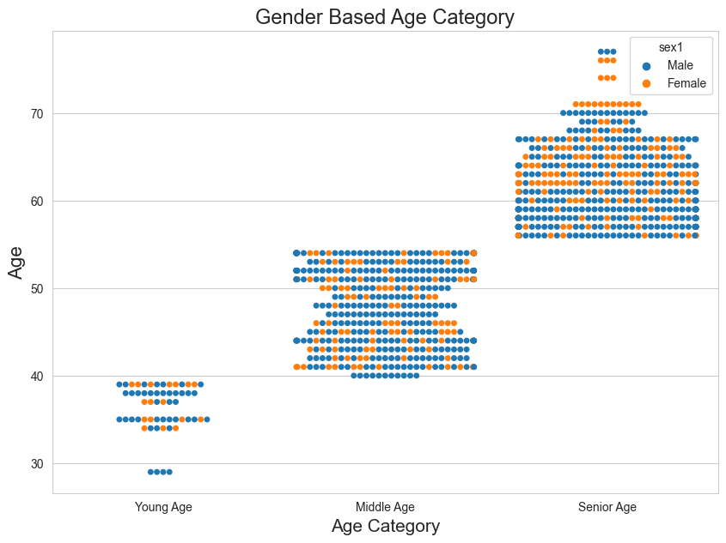
Data Analysis

Slide 7
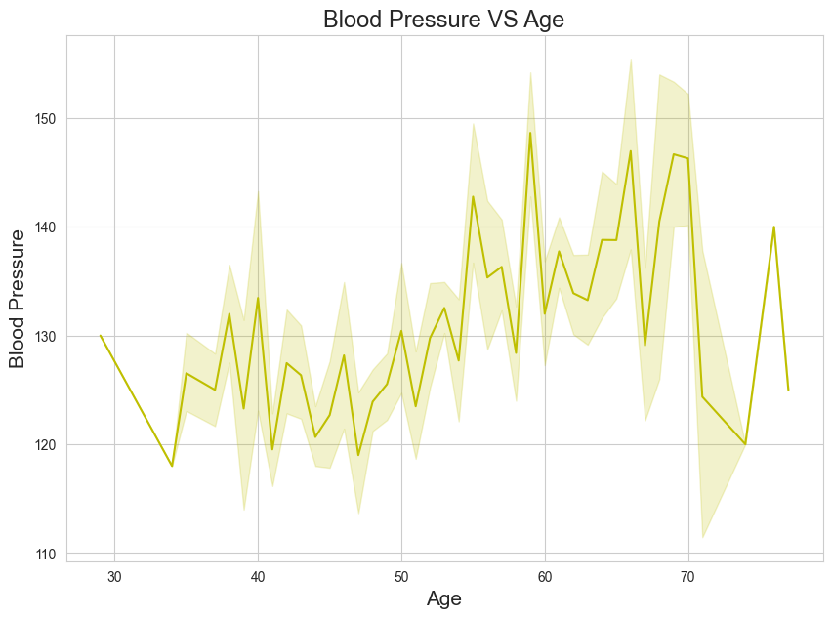
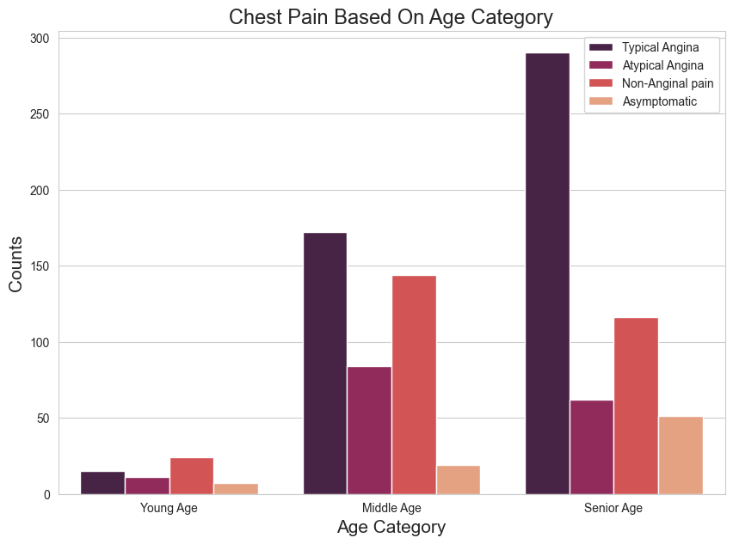
Data Analysis

Slide 8
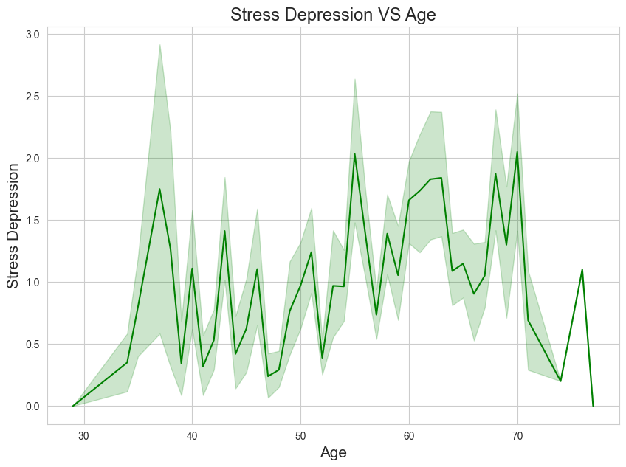
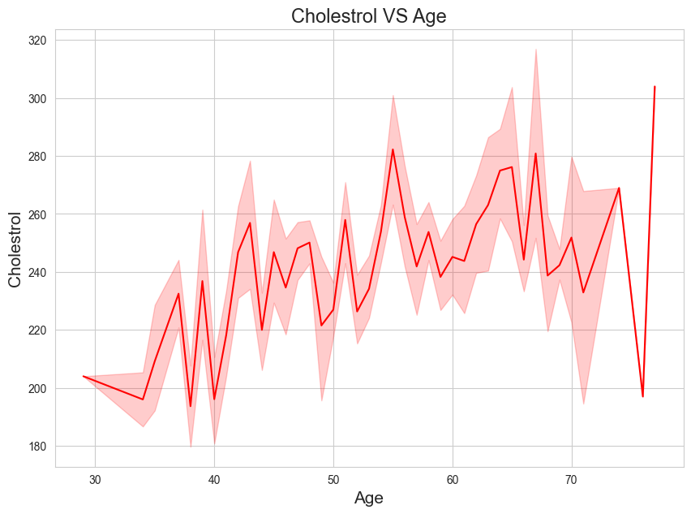
Data Analysis

Slide 9
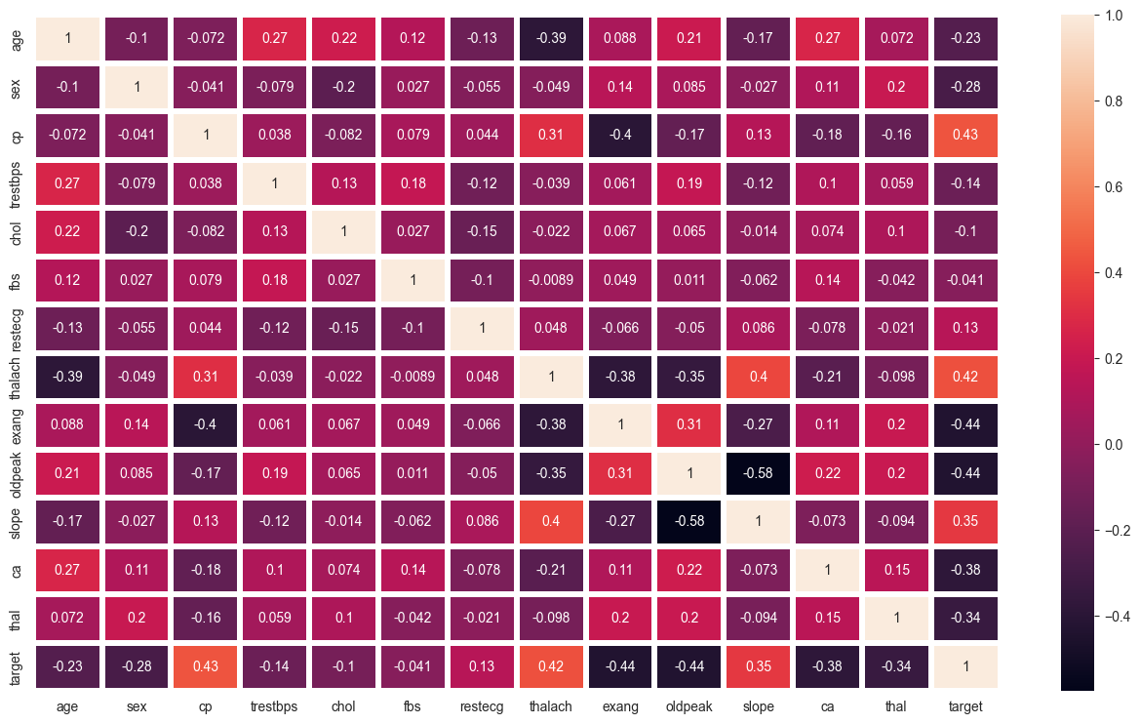
Data Analysis

Slide 10
Thank you

